Slide 1
Unit 3A
Human Diversity & Change
Variation and evolution
The gene pool

Slide 2

Study Guide
Read:
Our Human Species (3rd edtn)
Chapter 19, sections 4-5
Complete:
Human Biological Science Workbook
Topic 18 – Gene Pools

Slide 3
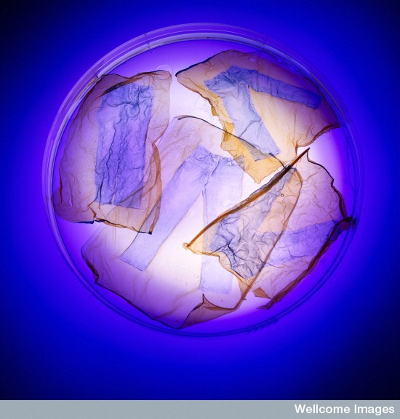
The gene pool
Wellcome Photo Library

Slide 4
The gene pool
A gene pool is the sum total of genes, with all their variations, possessed by a particular species at a particular time.

Slide 5
Changes in gene pools
The allele frequency in a population’s gene pool can be affected by evolutionary mechanisms, such as natural selection, or by chance occurrences, such as founder effect and random genetic drift.

Slide 6
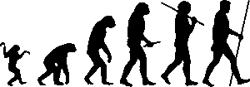
Natural selection
Natural selection provides a plausible explanation for evolution.

Slide 7
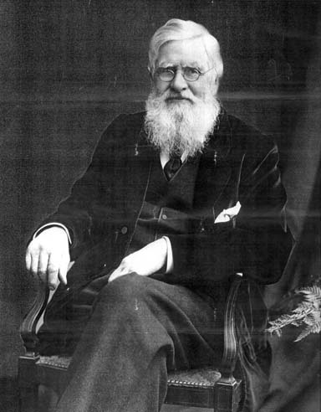
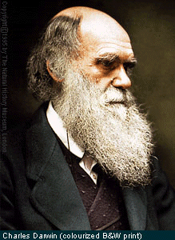
Natural selection
Alfred Wallace
Charles Darwin
Natural selection is the scientific theory proposed by Charles Darwin and Alfred Wallace that organisms best adapted to their environment tend to survive and out-multiply those that are less well adapted.

Slide 8
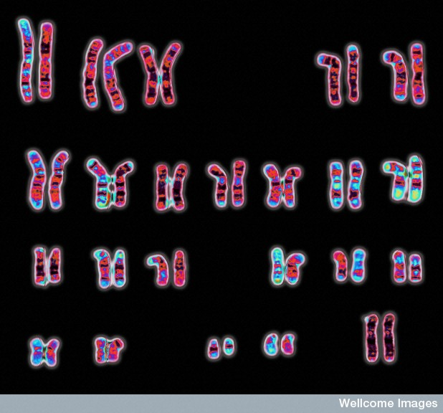
Wessex Reg. Genetics Centre,
Wellcome Images
The allele frequency is the relative frequency of a particular allele in a population. This ranges from 0 to 100 percent.
Natural selection affects the frequency of the alleles in a population’s gene pool. The frequency of alleles determining favourable features increases and the frequency of the alleles determining unfavourable features decreases.

Slide 9
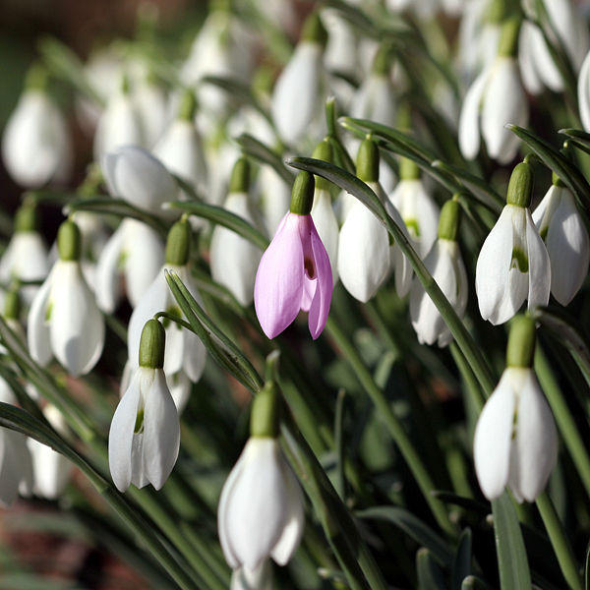
Mutations
Armin Kübelbeck

Slide 10
Mutations
A mutation is a permanent structural alteration in an organism’s DNA.
Mutations are an important source of genetic variation.
In most cases, DNA changes either have no effect or cause harm, but occasionally a mutation can improve an organism's chance of surviving.
Mutations in reproductive cells can be passed on to an organism’s descendants.

Slide 11
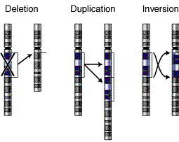
Three types of mutations
National Human Genome Research Institute - NIH

Slide 12
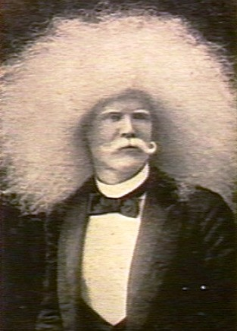
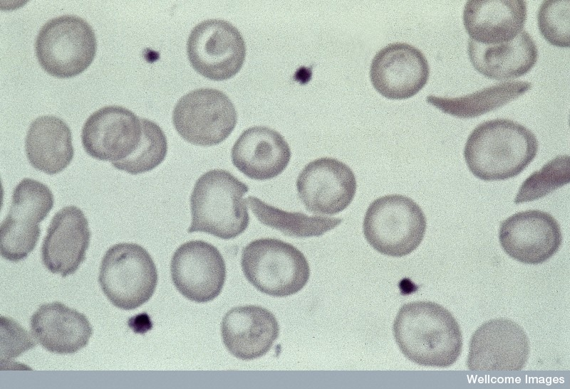
Albinism (left) and sickle cell trait (above) result from mutations.
Many human conditions result from genetic mutations.
Some, such as the sickle cell trait, are beneficial in some situations; whereas others, such as cancer, can be lethal.
Wellcome Photo Library

Slide 13
Natural selection determines which mutations remain in a gene pool, and which ones are eliminated.

Slide 14
Population size
In large populations:
Individuals make only a small contribution to the gene pool.
Evolution occurs slowly.
Most changes are adaptive.
Natural selection is the main driving force.

Slide 15
In small populations:
Individuals make a relatively large contribution to the gene pool.
Evolution can occur rapidly.
Many changes are non-adaptive.
Many changes are due to chance events.

Slide 16
Population bottlenecks
Anything that creates a sudden drop in population size (e.g. wars, natural disasters or migration), or prevents individuals from breeding, reduces mating possibilities and can cause a genetic bottleneck.

Slide 17
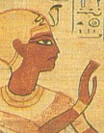
In-breeding
Reduced mating opportunities often lead to an increase in
in-breeding, or consanguinity.
In-breeding results in reduced genetic diversity in the population’s gene pool.
The Pharaoh and Inca nobility practised consanguinity to preserve the 'purity' of their gene line.

Slide 18
Consequences of in-breeding
In-breeding can result in non-adaptive changes occurring. Whereas it can amplify desirable traits, it can also greatly increase the risk of unusual, often harmful traits being expressed.

Slide 19
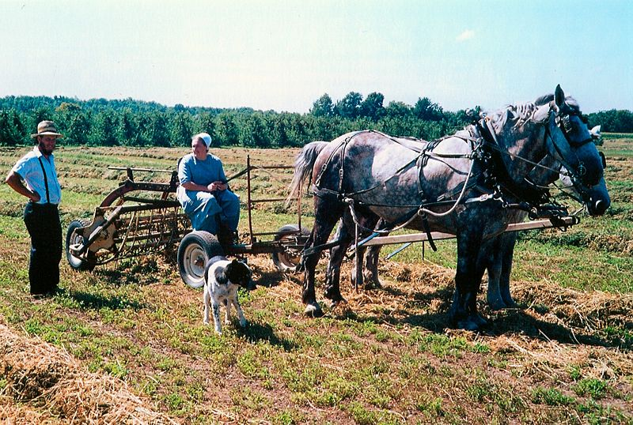
Consanguinity
Ernest Mettendorf
the Old Order Amish community of Lancaster County in Pennsylvania, USA is a fundamentalist religious sect who do not marry out or use modern technology.
The Amish community numbers around 18 000 people and shares only eight family names.
Within the community there is an above average incidence of inherited illnesses including a rare form of microcephally (small brain), albinism, dwarfism, cretinism, webbed fingers and limb girdle muscular dystrophy.

Slide 20
Genetic drift
Genetic drift is the random fluctuation of allele frequencies in a population from one generation to the next.
(e.g. the frequency of a particular trait could, for no obvious reason, drift from 2% in generation 1, to 11%
in generation 2, to 5% in generation 3 etc.)
Genetic drift is often a consequence of a genetic bottleneck i.e. it results from inbreeding brought about by the limited mating possibilities in a small community.

Slide 21
The effects of genetic drift
The effects of genetic drift can be amplified by differences in the number of children raised by couples, or individuals dying prematurely.
Genetic drift can result in:
  traits being lost from small populations.
  unusual traits, not commonly found in the parent population, and that are often non-adaptive, becoming established.

Slide 22
Founder effect
Founder effect is an example of a genetic bottleneck.
Founder effect occurs when a small number of people migrate and settle in a new area.
The founding population carry only a small fraction of the original population's genetic variation. As a result, they may differ both genetically and in appearance, compared with the parent population.

Slide 23
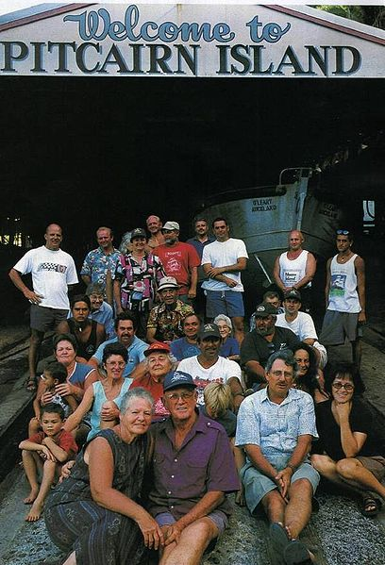
Founder effect
Pitcairn Island, in the Pacific, was colonised by the mutineers from HMS Bounty in 1790.
Today the population of the island is around 44 people.

